Slide 1
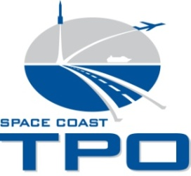
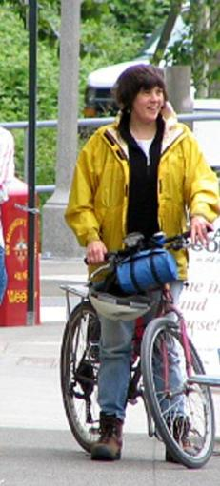
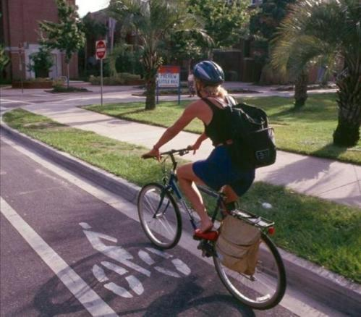

Slide 2
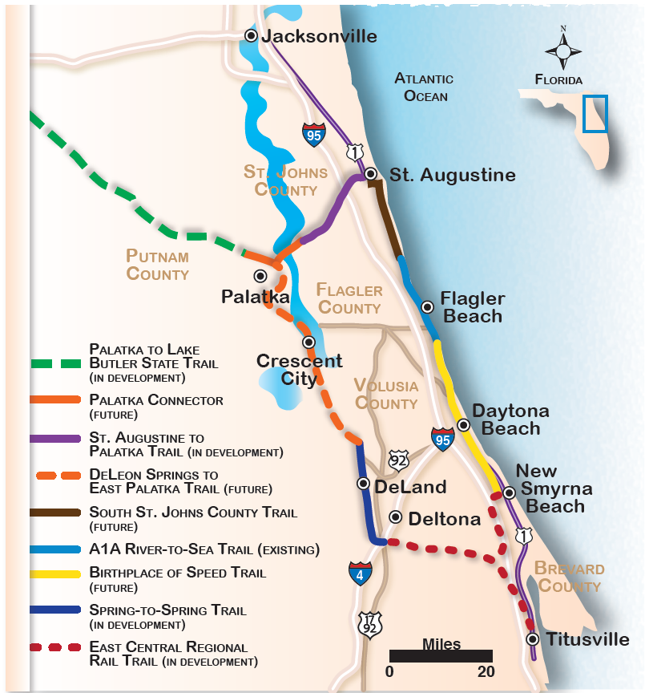
St. Johns River-to-Sea Loop
St. Johns River-to-Sea Loop

Slide 3
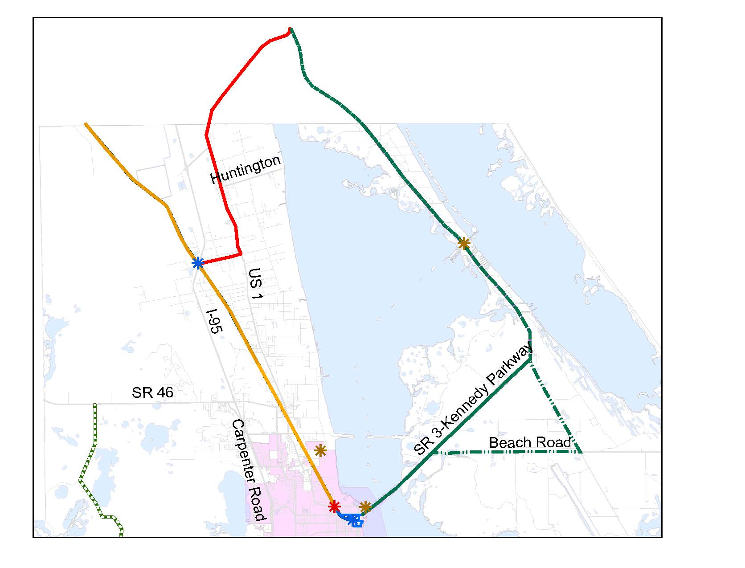
Space Coast Loop Trail

Slide 4
Coast-to-Coast Connector

Slide 5
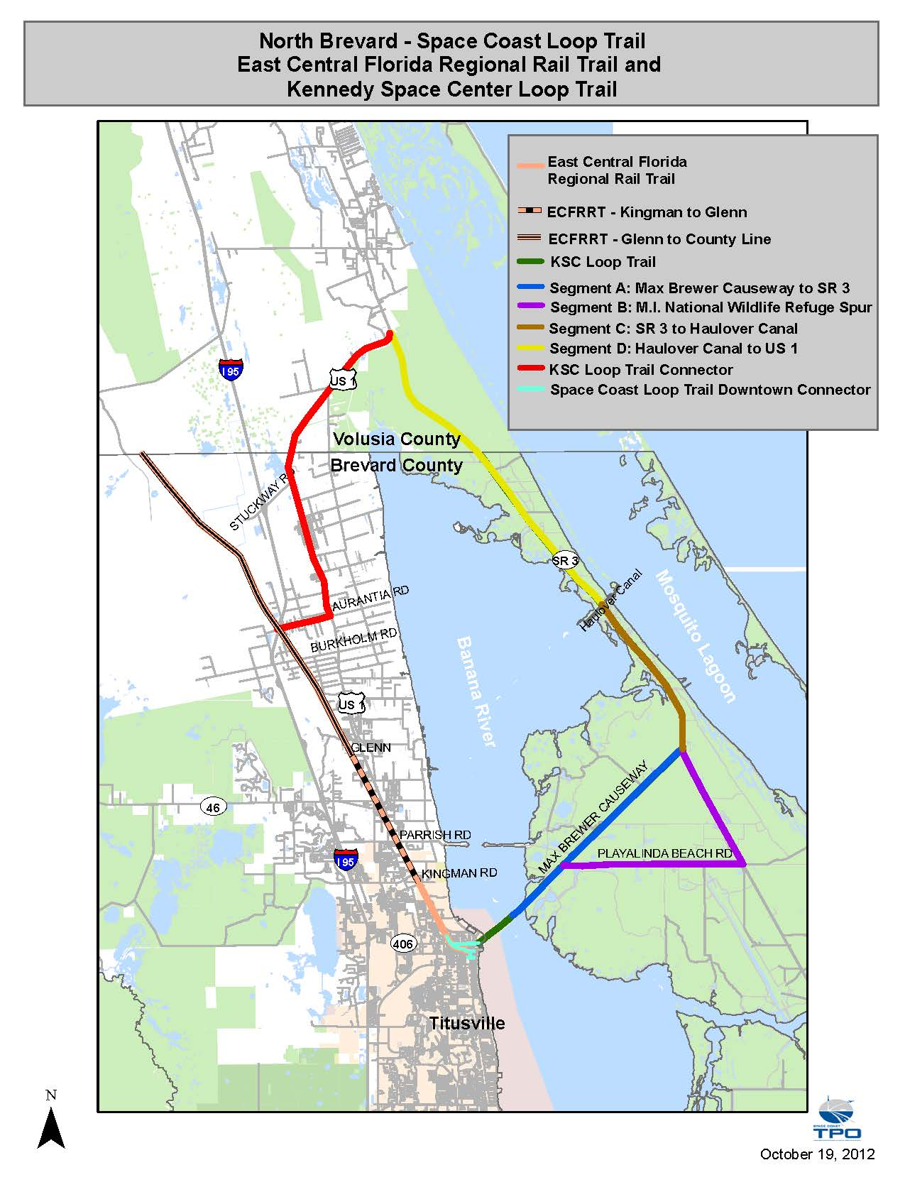
Space Coast Loop Trail
East Central Florida Regional Rail Trail
Kennedy Space Center Loop Trail
55 miles total

Slide 6
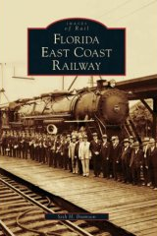
Space Coast Loop/Rail Trail
EAST CENTRAL FLORIDA REGIONAL RAIL TRAIL
Railroad Built – 1880s
FEC Railroad Discontinued - 1960’s
Acquired by FDEP Office of Greenways and Trails – Dec 2007
Leased back to Brevard and Volusia for use as trail – Sep 2008

Slide 7
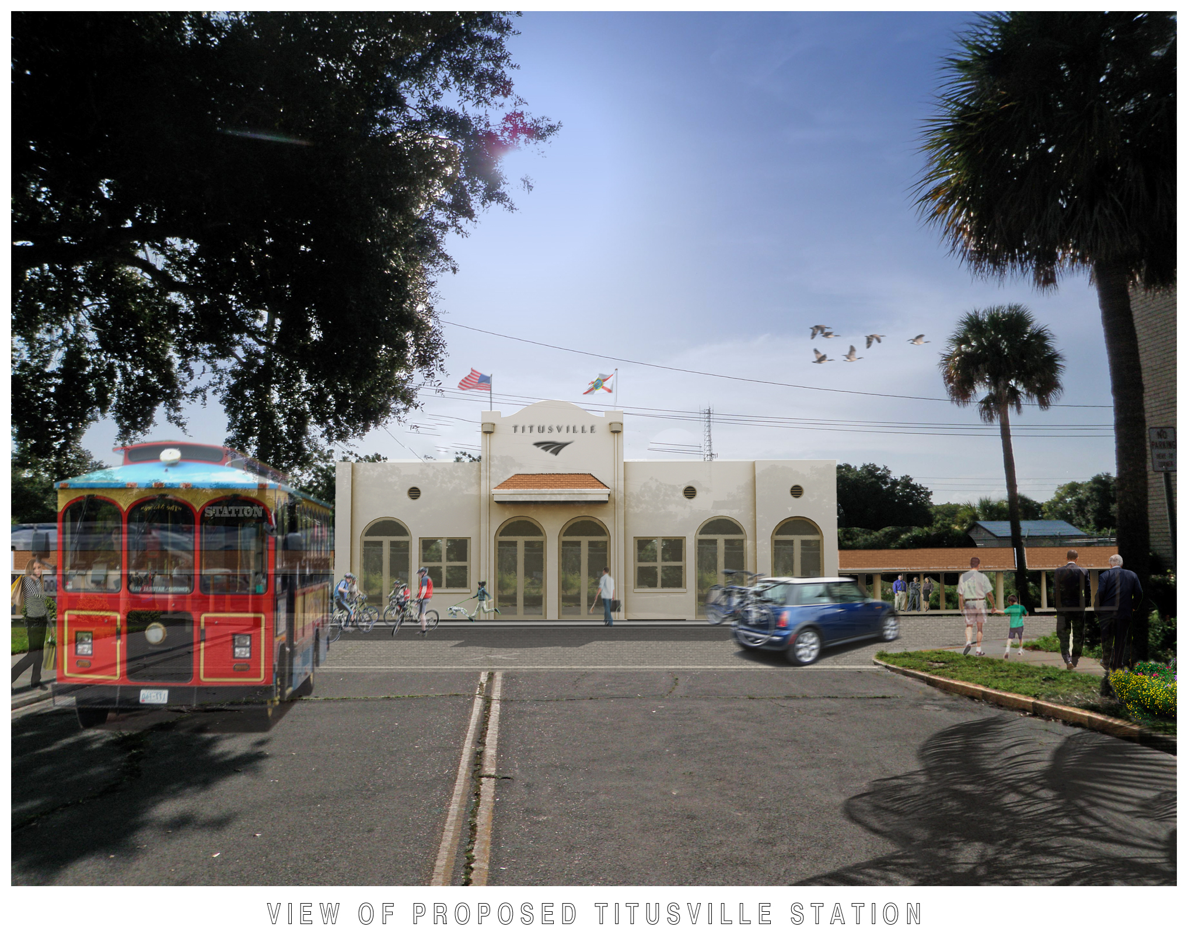

Slide 8
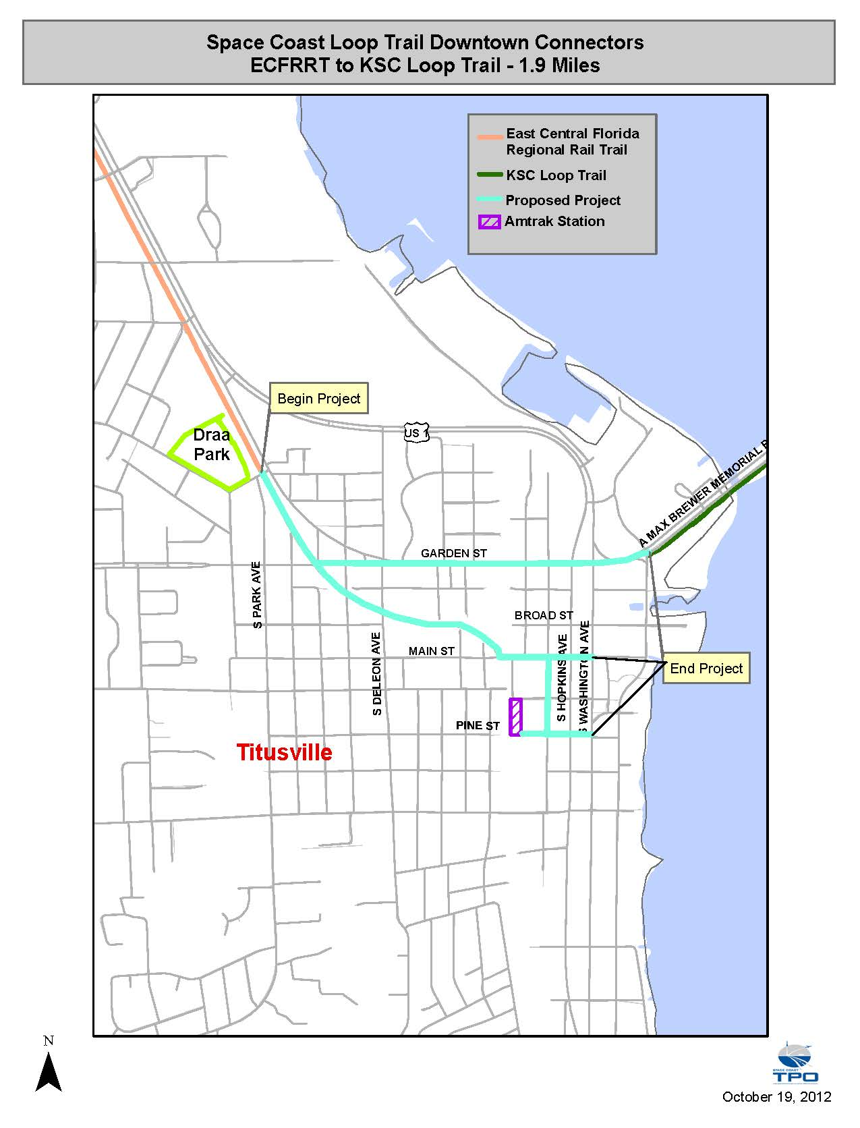
Space Coast Loop Trail
Downtown Connectors
Urban Trail
1.9 miles

Slide 9
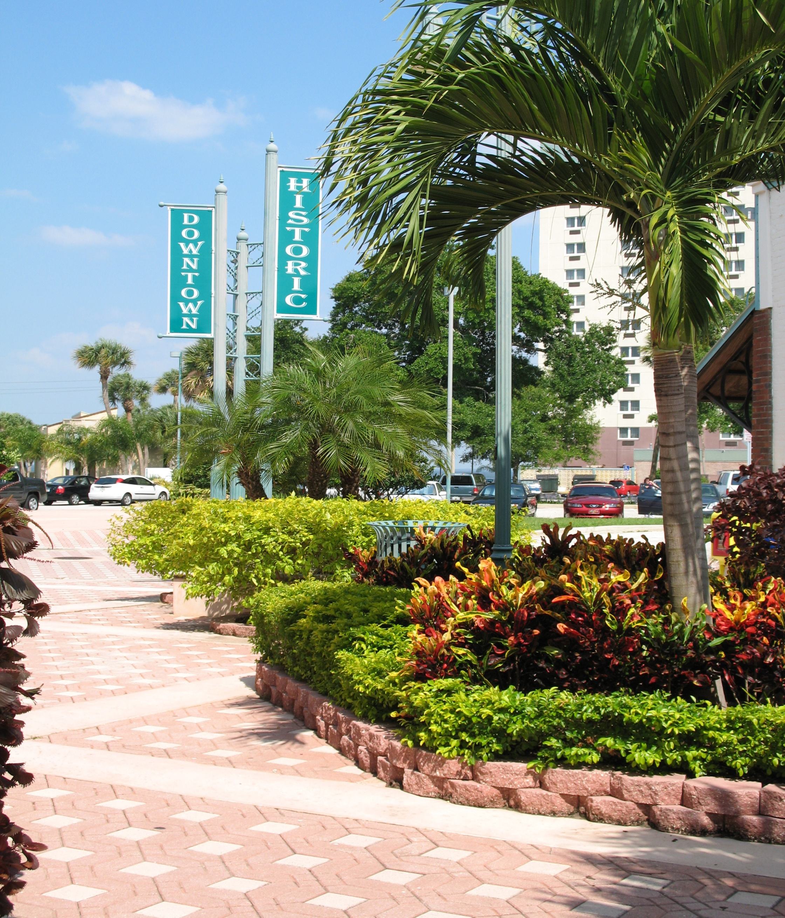

Slide 12
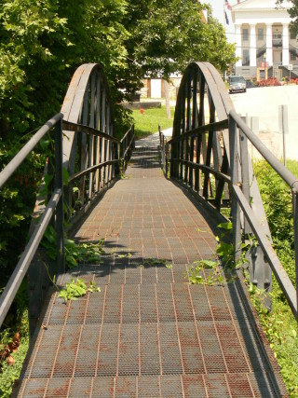
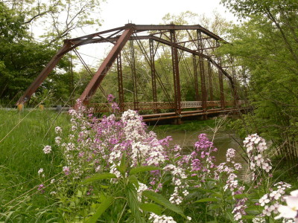
Space Coast Loop/Rail Trail
Garden Street Crossing
2014 Design/Build
2016 COMPLETE

Slide 13
Space Coast Loop Trail
Downtown Segment
Draa Park to Kingman Road
1.4 miles
2013 Construction
2014 COMPLETE

Slide 14
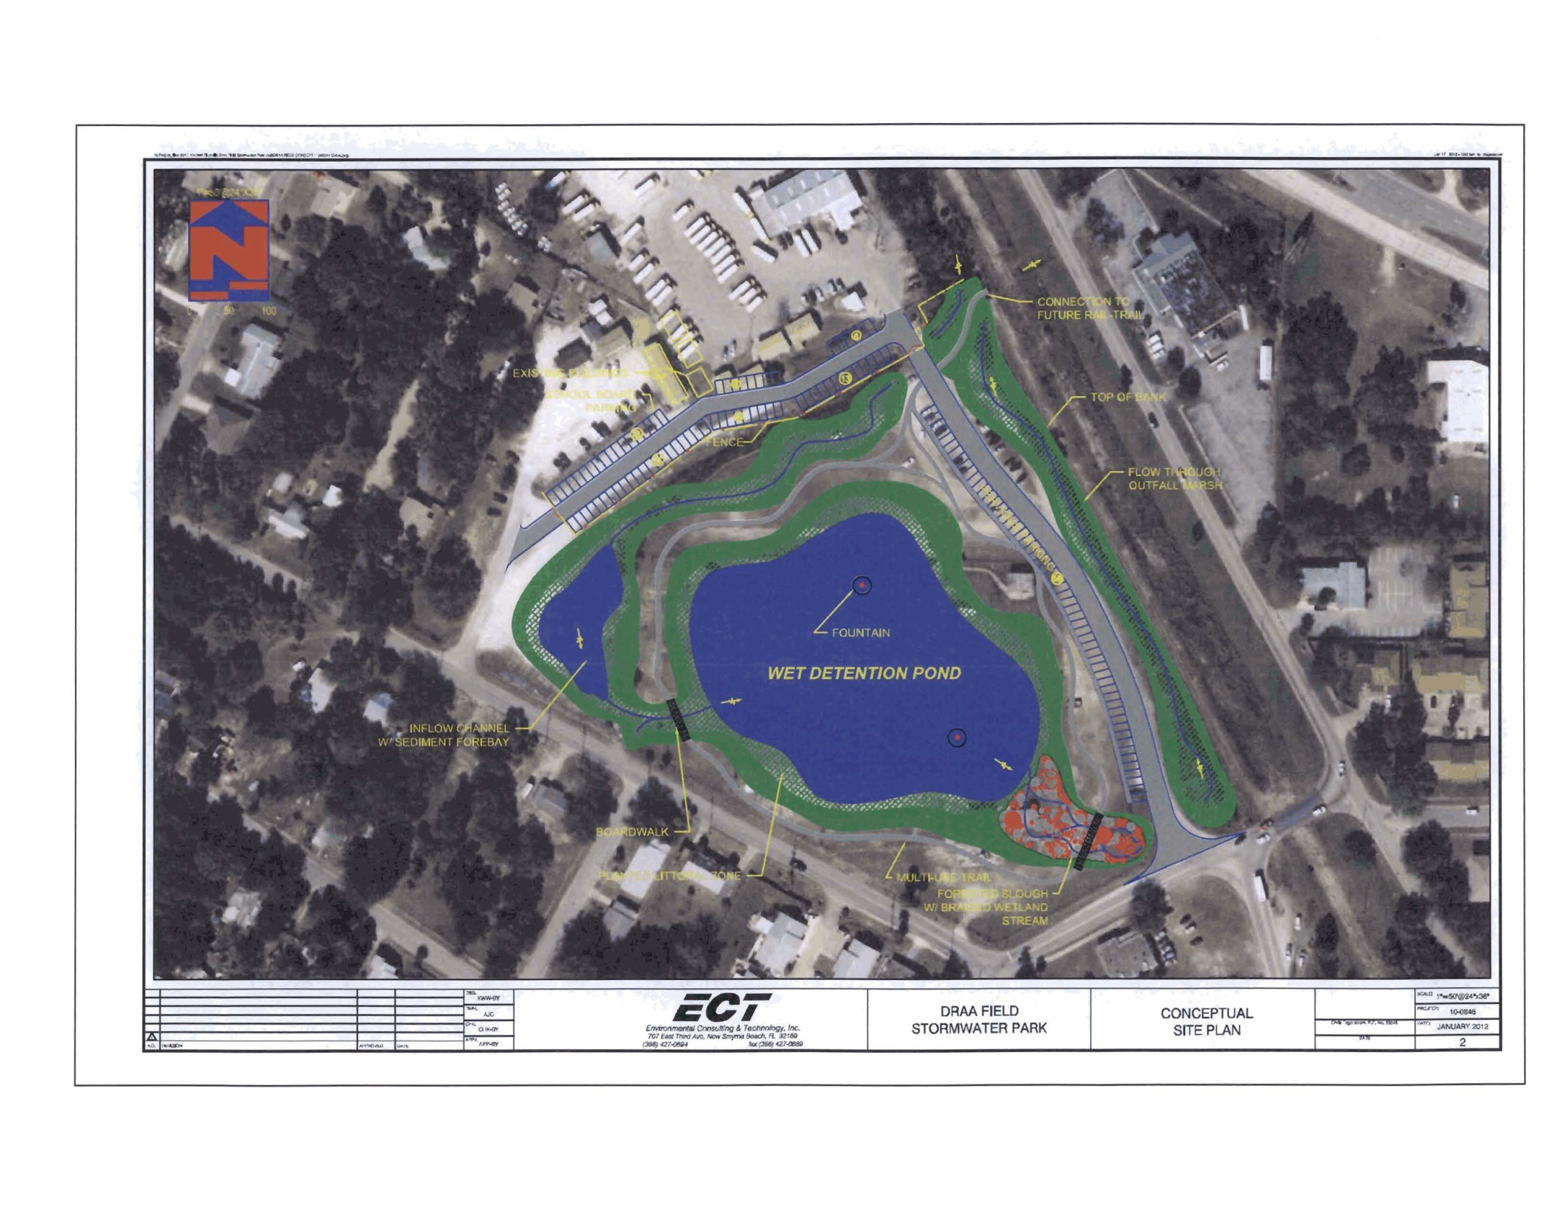

Slide 15
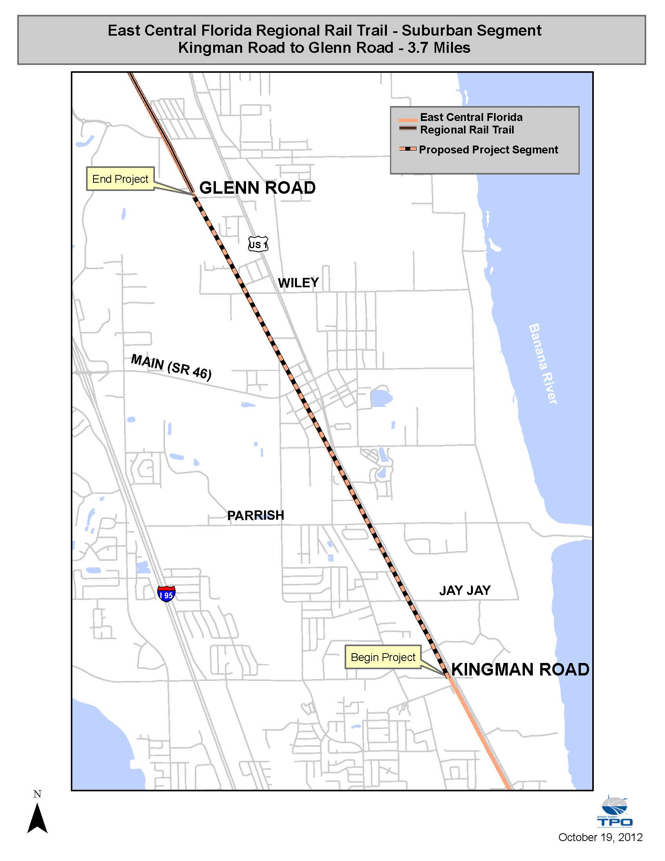
Space Coast Loop Trail
Suburban Segment
Kingman Road to Glenn Road
3.7 miles
2014 Design/Build
2016 COMPLETE

Slide 16
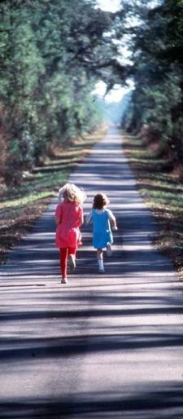
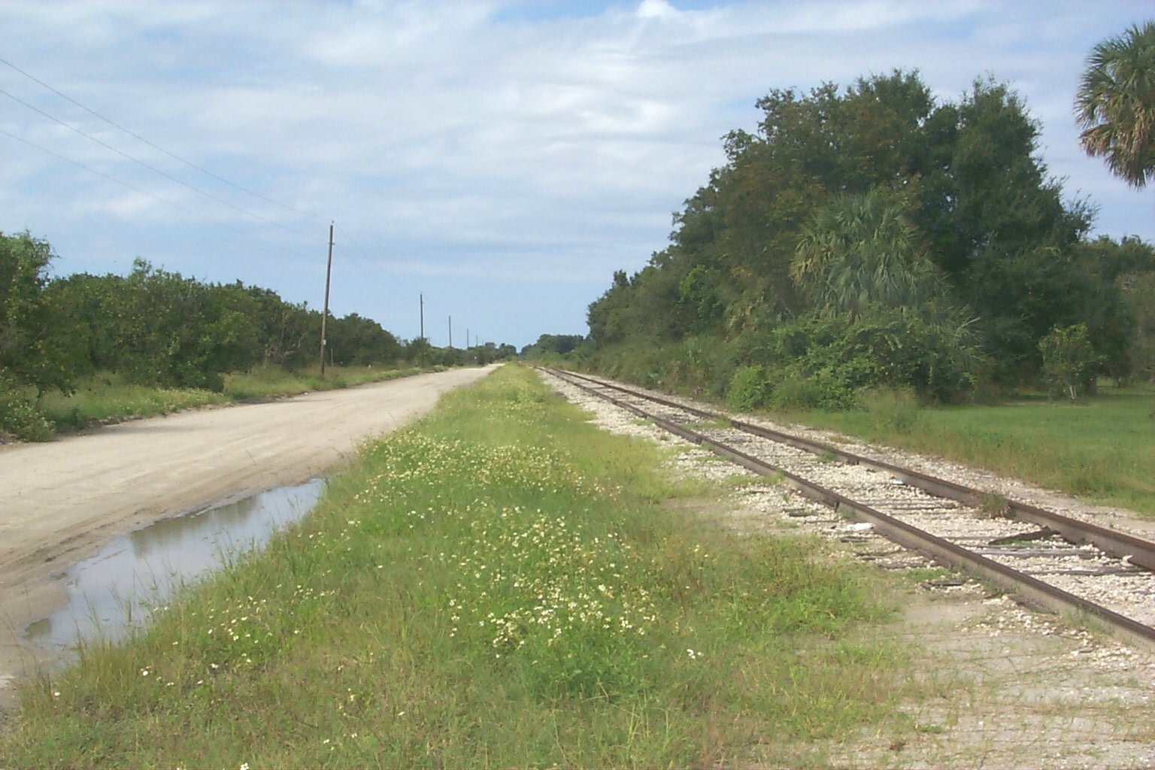
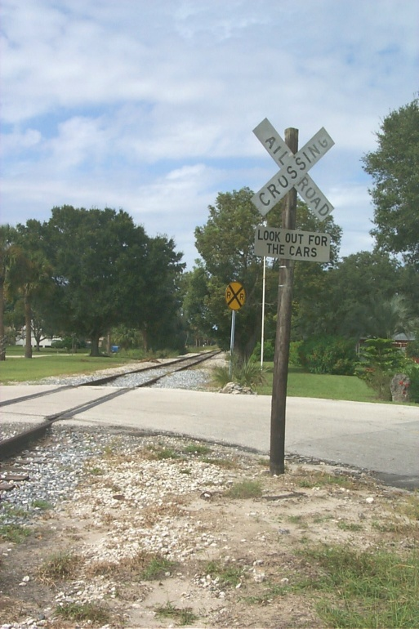

Slide 17
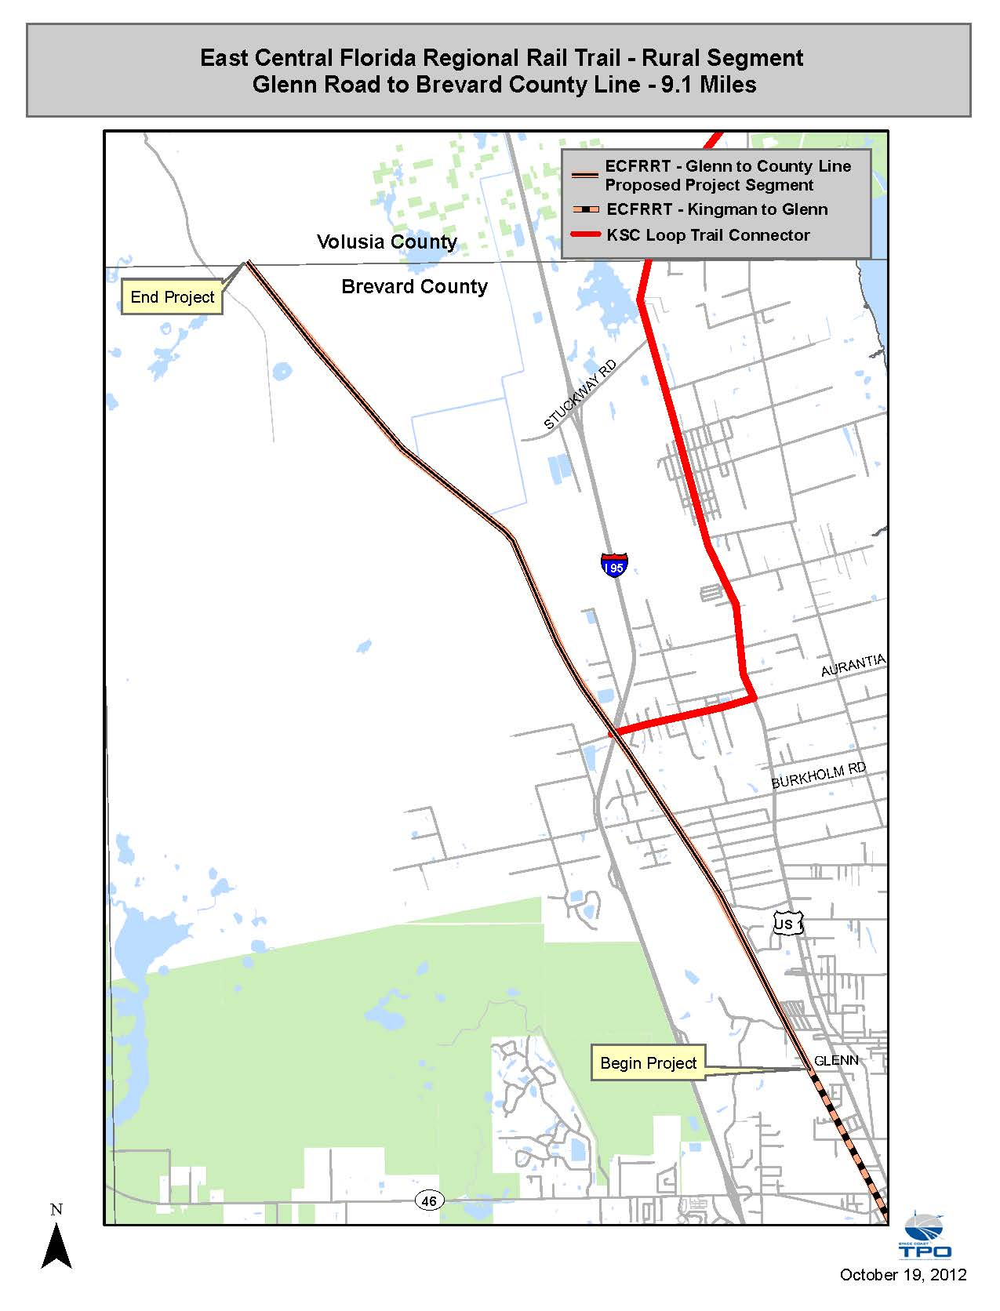
Space Coast Loop Trail
Rural Segment
Glenn Road to county line
9.1 miles
2018 Design/Build
2020 COMPLETE

Slide 19
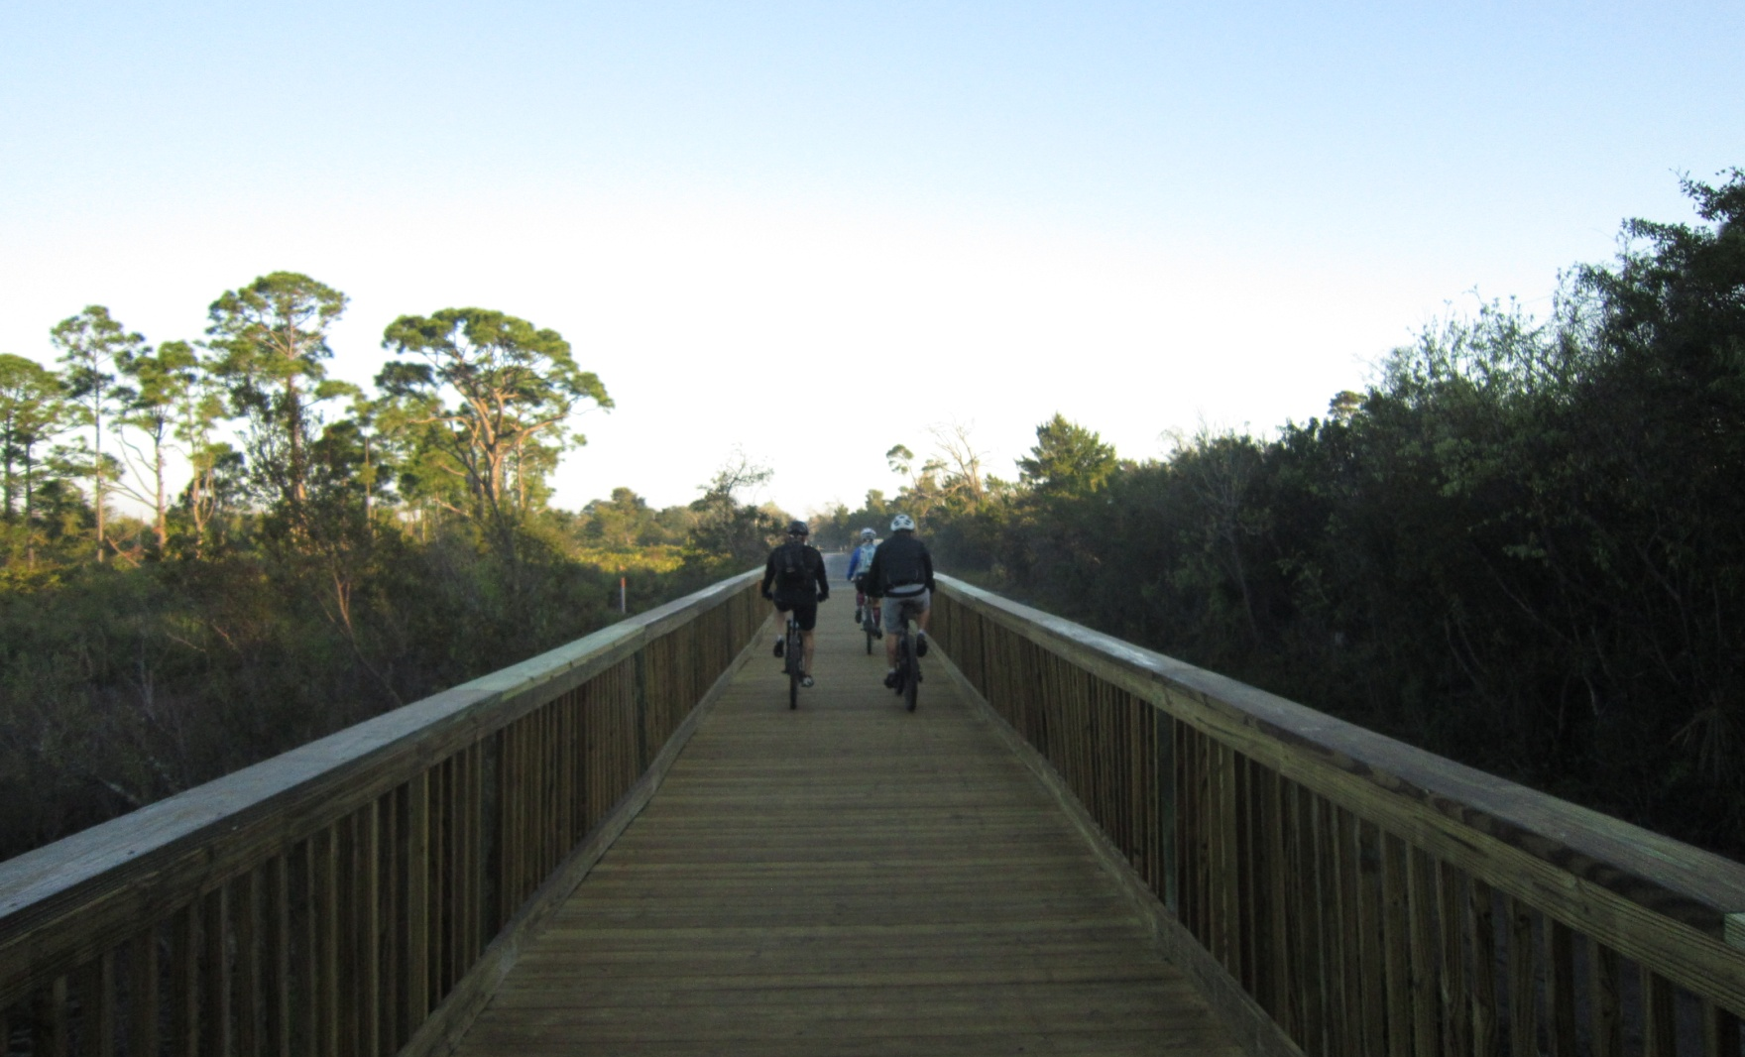
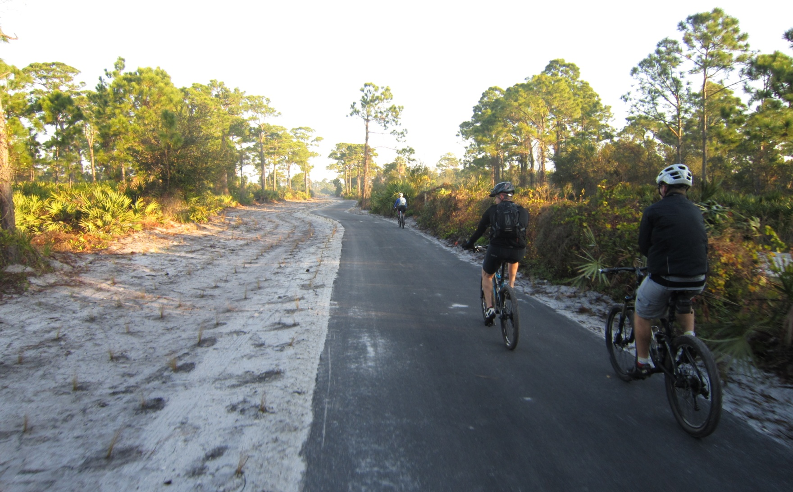

Slide 20
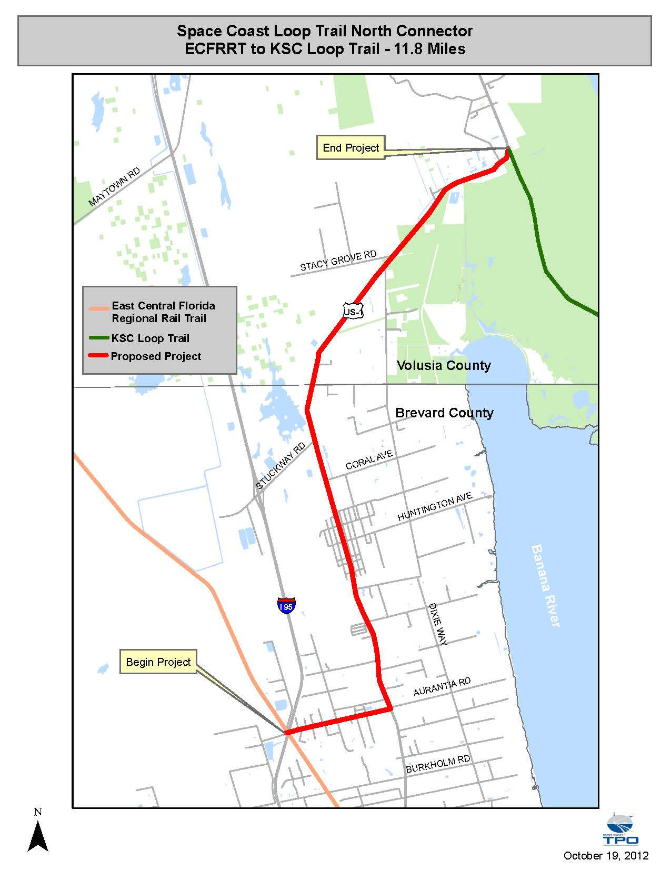
Space Coast Loop Trail
North Connector Segment
Aurantia Road to U.S. 1
11.8 miles
On Road

Slide 21
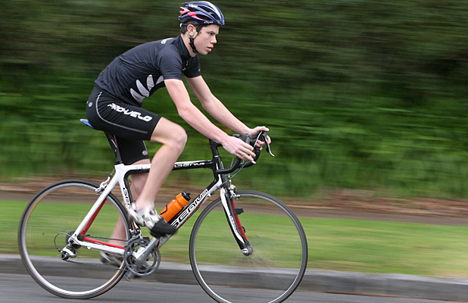

Slide 22
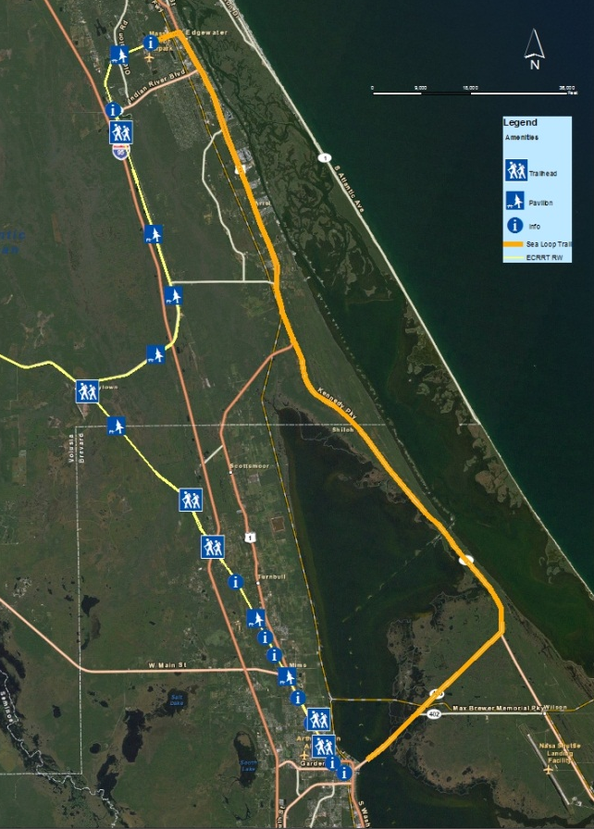
Space Coast Loop/KSC Loop Trail
Edgewater
Preliminary Design
Environmental Assessment
Titusville to Edgewater
2013 Complete
2015: Request $$
for Design/Build
Titusville

Slide 23
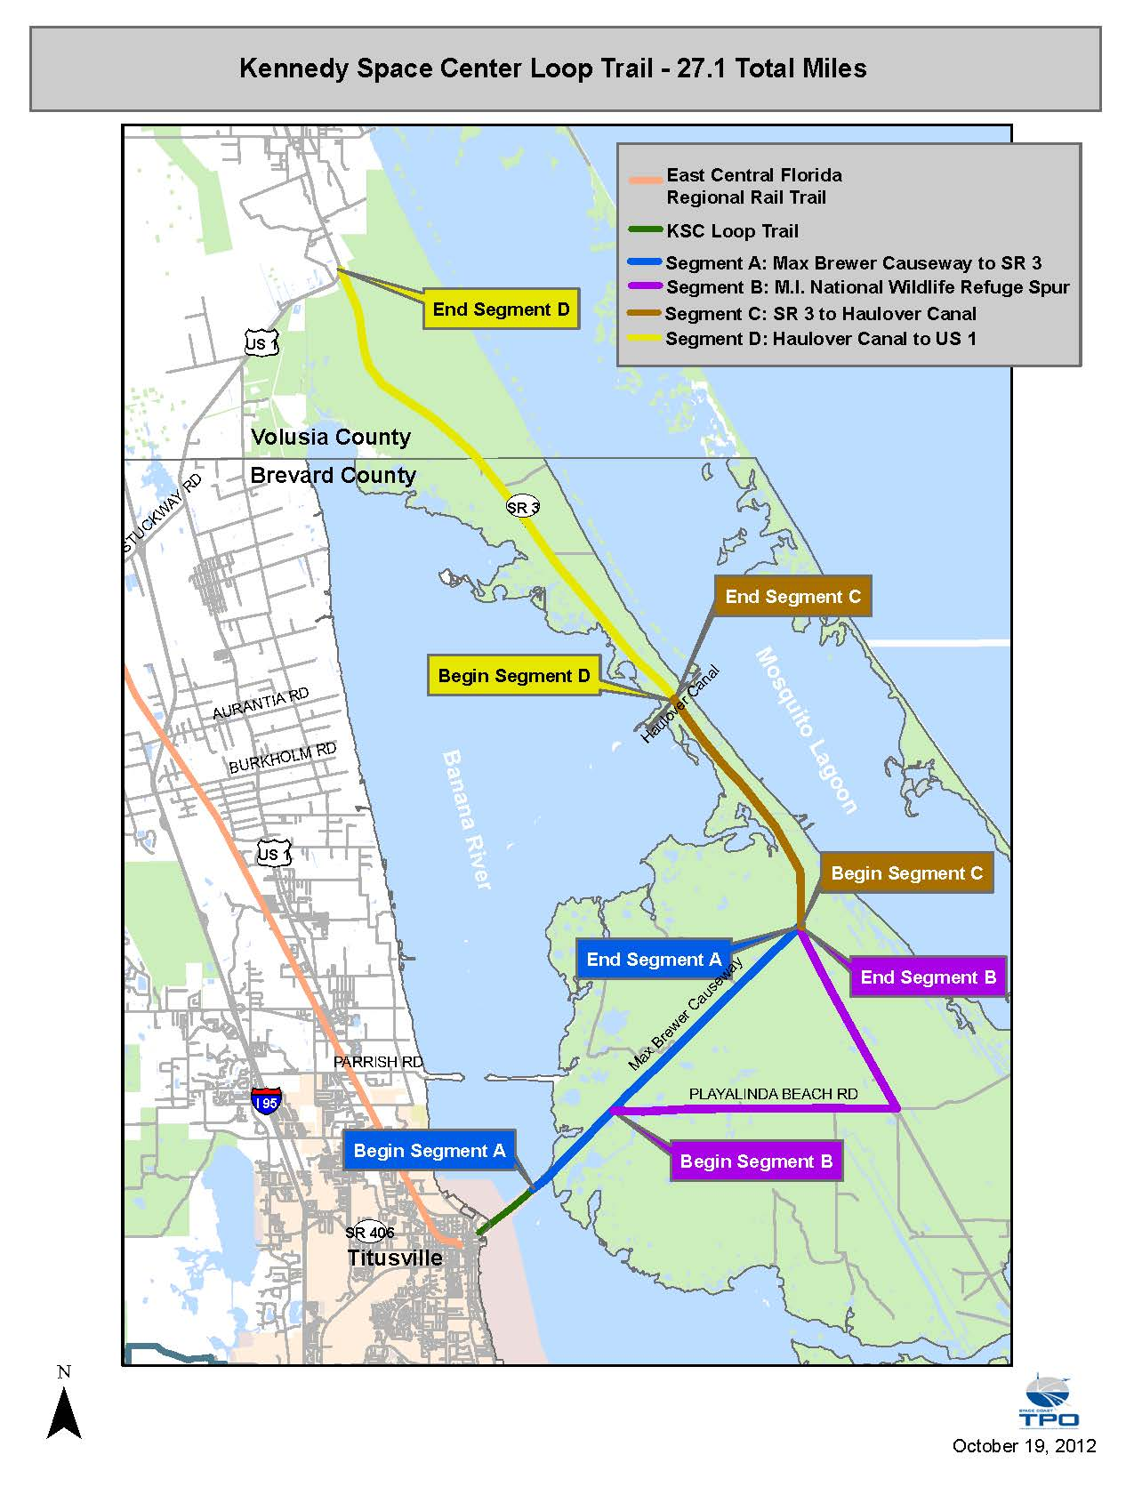
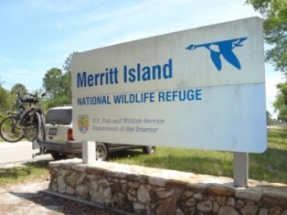
Space Coast Loop Trail

Slide 24
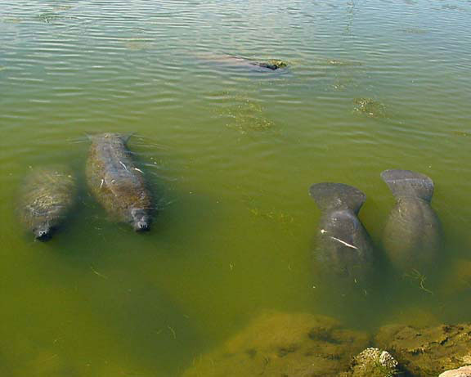
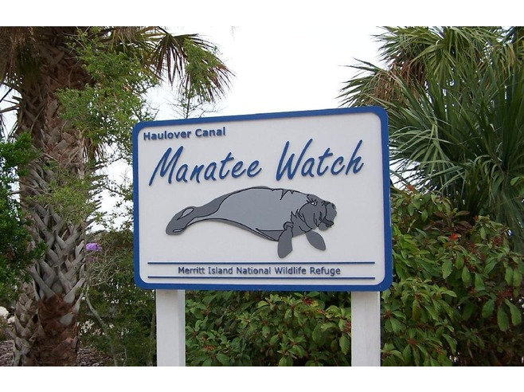
Space Coast Loop Trail
Haulover Canal to U.S. 1
8.7 miles

Slide 25
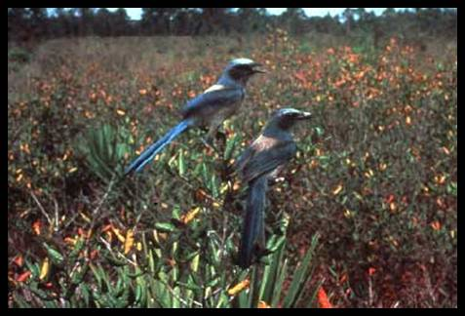
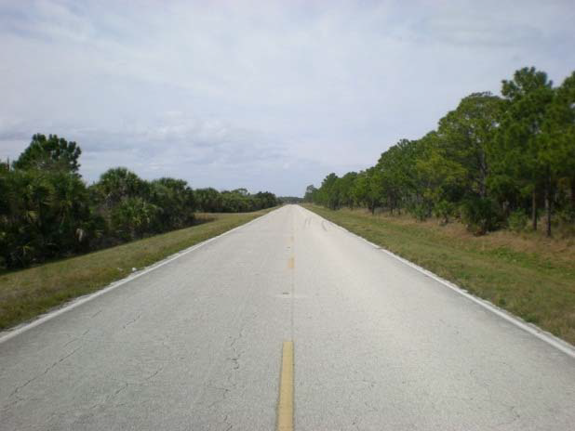
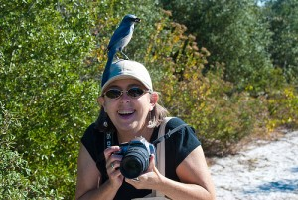
Space Coast Loop Trail
SR 3 to Haulover Canal
4.2 miles

Slide 26
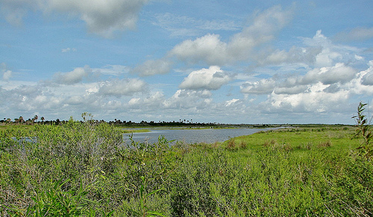
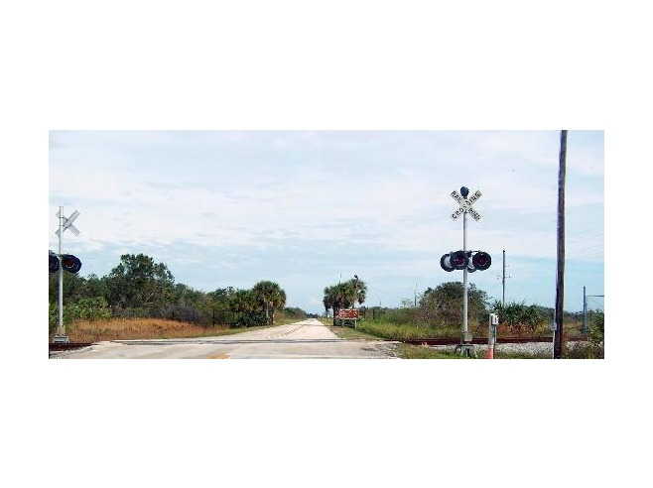
Space Coast Loop Trail
Max Brewer Causeway/SR 3
6.4 Miles

Slide 27
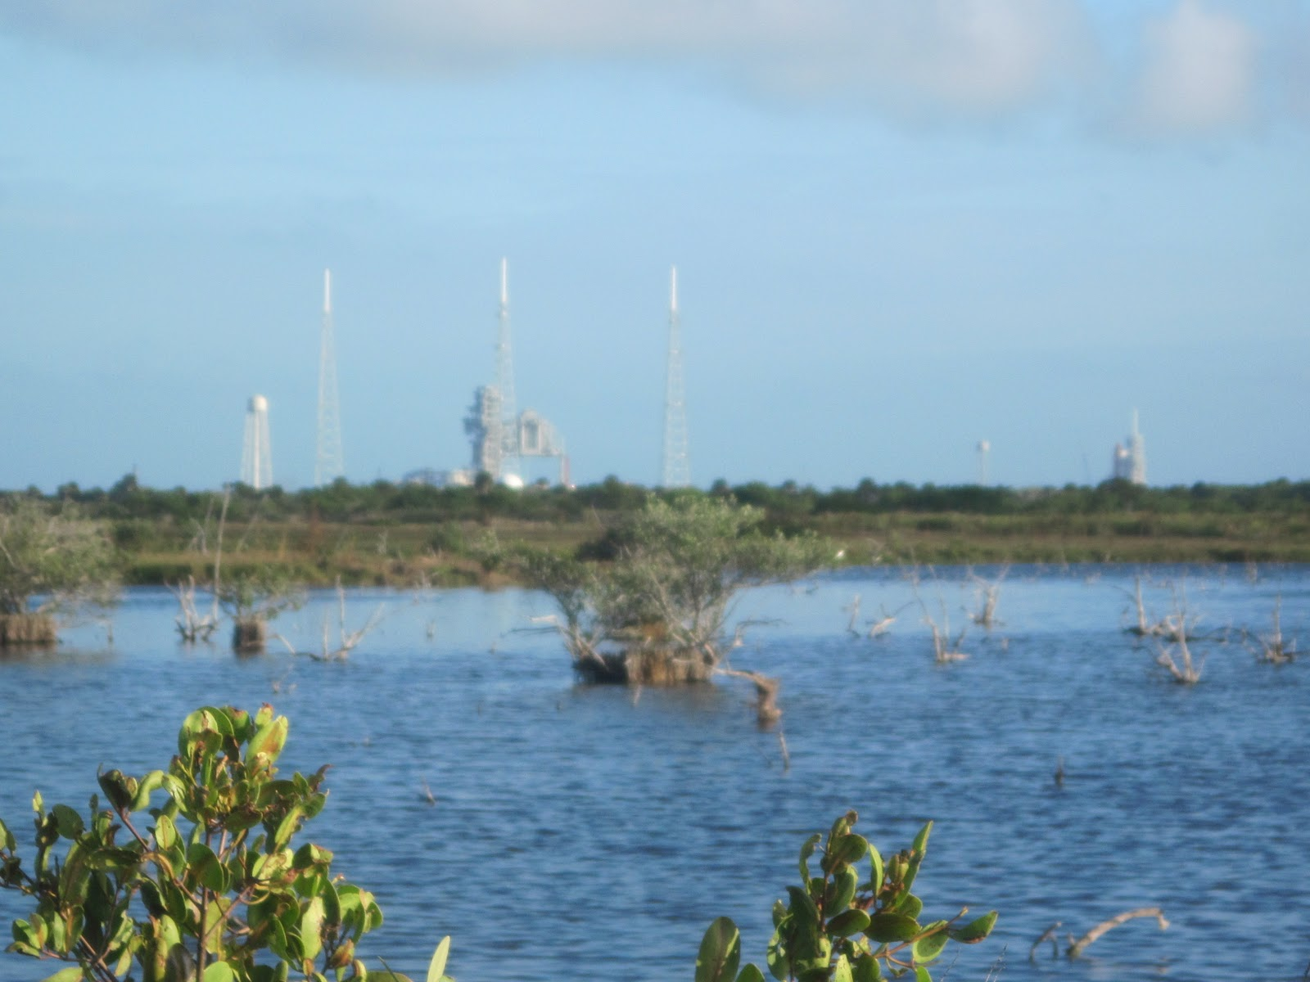
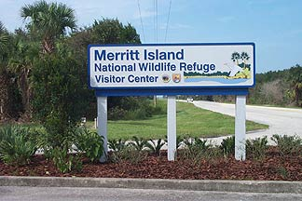
Space Coast Loop Trail
Merritt Island National Wildlife Refuge Spur
7.8 Miles

Slide 28
